Slide 1
Few Shot Learning for TCR-Epitope Binding Affinity Prediction
Ajay Kannan

Slide 2
Dataset - 1:1
Train - Number of data points in the dataset: 500K positive pairs and 500K negative pairs (total 1M pairs)
Ratio of positive to negative pairs: 1:1
Positive - mutually inclusive data with respect to epitope and a positive binding
Negative - Mutually exclusive data with respect to epitope (epitope 1 != epitome 2) and negative binding
Data augmentation techniques used
Siamese network with L1-norm loss and cross-entropy loss

Slide 3
Experimental Setup
Number of pairs used for training, validation, and testing: 100,000 pairs for training and 10,000 pairs each for validation and testing
For running it laptop, train 18K pairs; validation 2K pairs; test 2K pairs
Different positive to negative ratios tested: 1:20, 1:8, and 1:1
Evaluation metric used: testing accuracy, F1, precision and recall

Slide 4
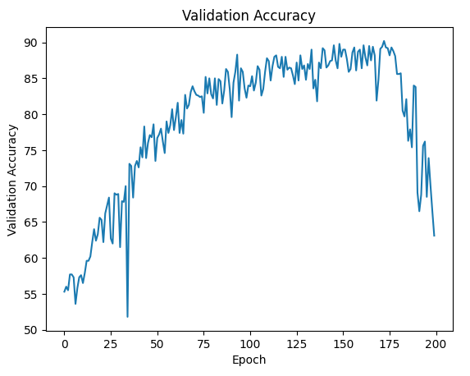
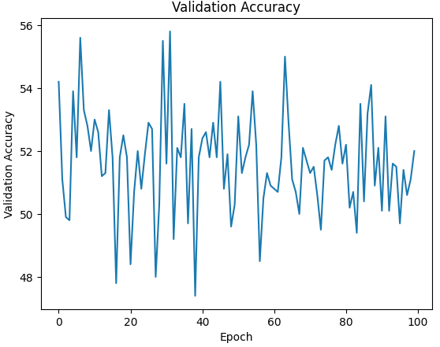
Results
Testing accuracy achieved with different ratios
Efficiency achieved with 1:1 ratio for full dataset and less data - 100K pairs
Graph of validation accuracy
Left: Training accuracy; Right: Validation Accuracy

Slide 5
Epitope Split
Number of epitopes in the dataset
Selection of 5 most common epitopes for the split
Seed used for the split - 50
Number of pairs used for training, validation, and testing for the epitope split –
SAMPLE - Train: 20K pairs, Test: 2K pairs
Whole dataset – Train: Test – 1M: 200K

Slide 6
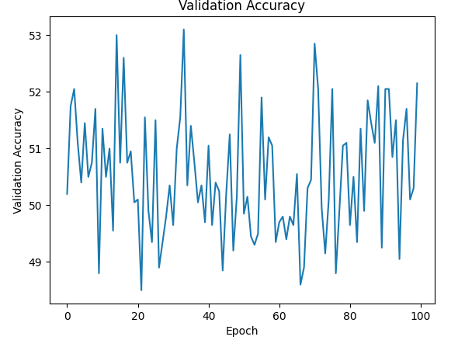
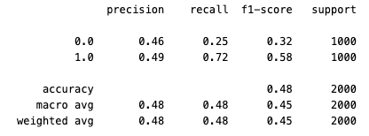
Results for 5 Epitope Split
Testing accuracy achieved for each epitope
Comparison of testing accuracy for the full dataset and the epitope split
Graph of validation accuracy for the epitope split
Sample Dataset
Creation of a sample dataset for testing locally
Size of the sample dataset:
Train - 20K pairs
Test – 2K pairs

Slide 7
Epitope Split 3-2
Number of epitopes in the dataset
Selection of 5 most common epitopes for the split.
But the most abundant epitopes are split as Training: Test – 3:2
The rest are the same
Seed used for the split - 50
Number of pairs used for training, validation, and testing for the epitope split –
SAMPLE - Train: 20K pairs, Test: 2K pairs
Whole dataset – Train: Test – 1M: 200K

Slide 8
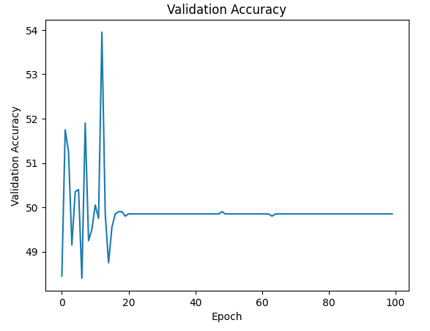
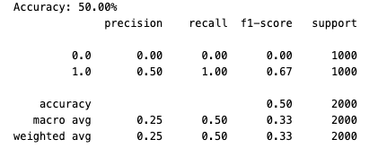
Results for 3-2 Epitope Split
Testing accuracy achieved for each epitope
Comparison of testing accuracy for the full dataset and the epitope split
Graph of validation accuracy for the epitope split
Sample Dataset
Creation of a sample dataset for testing locally
Size of the sample dataset:
Train - 20K pairs
Test – 2K pairs

